Slide 1
Optimizing Promotions with Analytics
BUS256 Marketing Analytics

Slide 2
Agenda & Goals
Experiments -> Quasi Experiments
Regression in R with training and test sets
Package car – Companion t Applied Regression
More data preparation with dplyr
Discussion about final project

Slide 3
Why organizations should create experimental ecosystems

Slide 4
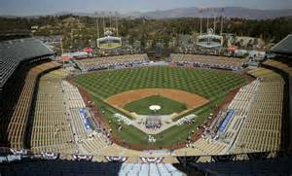
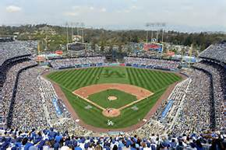
The LA Dodgers – Promotions to Fill Dodger Stadium

Slide 5
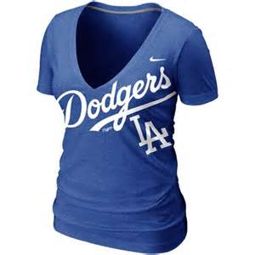


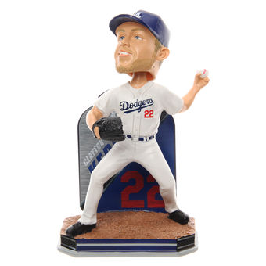
Variables
Target: Attendance
Covariates
Month
Day
Opponent
Temp
Skies
Day/Night
Treatments

Slide 6
Design and Analysis Plan
Non-random assignment of treatments across games
Cap (2)
Shirt (3)
Fireworks (14)
Bobblehead (11)
Nothing (51)
Multiple regression: Attend ~ some factors

Slide 7

# define an ordered day-of-week variable
# for plots and data summaries
dodgers$ordered_day_of_week <- with(data=dodgers,
ifelse ((day_of_week == "Monday"),1,
ifelse ((day_of_week == "Tuesday"),2,
ifelse ((day_of_week == "Wednesday"),3,
ifelse ((day_of_week == "Thursday"),4,
ifelse ((day_of_week == "Friday"),5,
ifelse ((day_of_week == "Saturday"),6,7)))))))
dodgers$ordered_day_of_week <- factor(dodgers$ordered_day_of_week, levels=1:7,
labels=c("Mon", "Tue", "Wed", "Thur", "Fri", "Sat", "Sun"))

Slide 8
An alternative from package plyr: mapvalues
days <- levels(dodgers$day_of_week) # daynames alphabetically
# we want Mon = 1, Tues = 2, etc
daynum <- c(5, 1, 6, 7, 4, 2, 3) # Fri = 5, Mon = 1
dodgers$ordered_day_of_week <- mapvalues(dodgers$day_of_week, from = days, to = daynum)
mydodger$ordered_day_of_week <- factor(dodgers$ordered_day_of_week, levels=1:7,
labels=c("Mon", "Tue", "Wed", "Thur", "Fri", "Sat","Sun"))

Slide 9
Standard Graphics and Lattice Graphics
See Miller 08 lines 22 – 44 for Standard
Lattice: for comparative plots– small multiple graphs
See lines 46 – 64 and handout

Slide 10
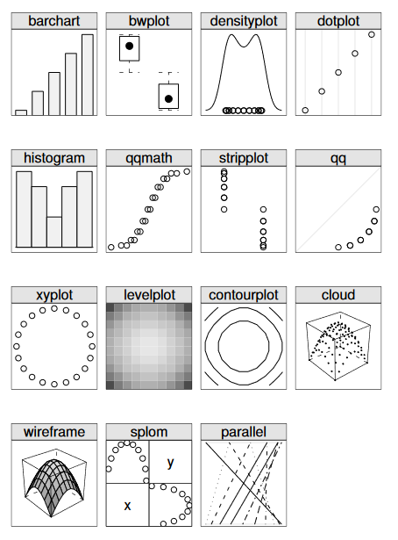
LATTICE basics
Create grid of plots
Can control # rows and cols
Essential syntax (example)
xyplot(y ~ x| z, data= , pch=)

Slide 11
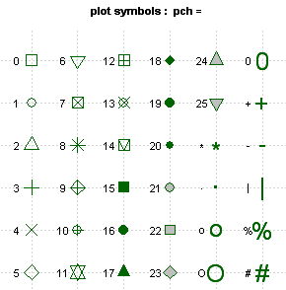
Graph Symbols and sizes: PCH and CEX
PCH = Plot Character
CEX = Character Expansion (or Extention)… Proportion by which to scale a PCH or label
http://www.statmethods.net/advgraphs/parameters.html

Slide 12
Regression + Diagnostics
Basic function: lm (linear model)
Model <- lm (Y ~ x1 + x2 + x3, data= )
Fitted model object contains coefficients, fitted, residuals…
Predict command: predict(model, newdata= )
Package car adds diagnostic capabilities

Slide 13
Regression with Interaction
Example:
my.model <- {attend ~ ordered_month + ordered_day_of_week + bobblehead}
my.model <- {attend ~ ordered_month + ordered_day_of_week + bobblehead + ordered_day_of_week * bobblehead}

Slide 14
Final project question
The Kaggle possibility…

